Slide 1
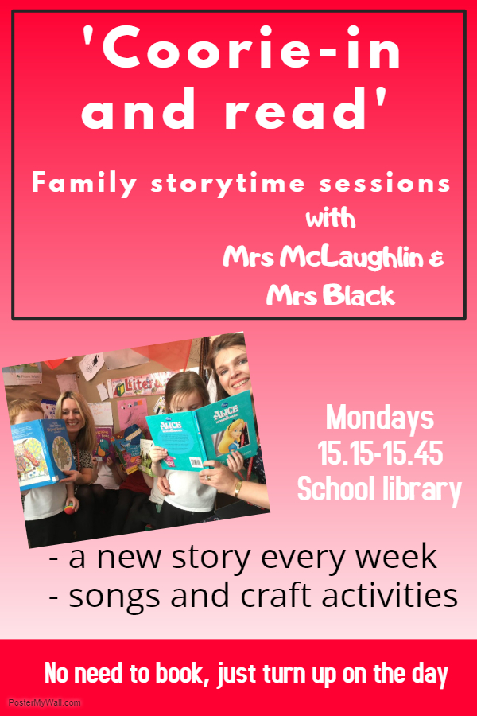
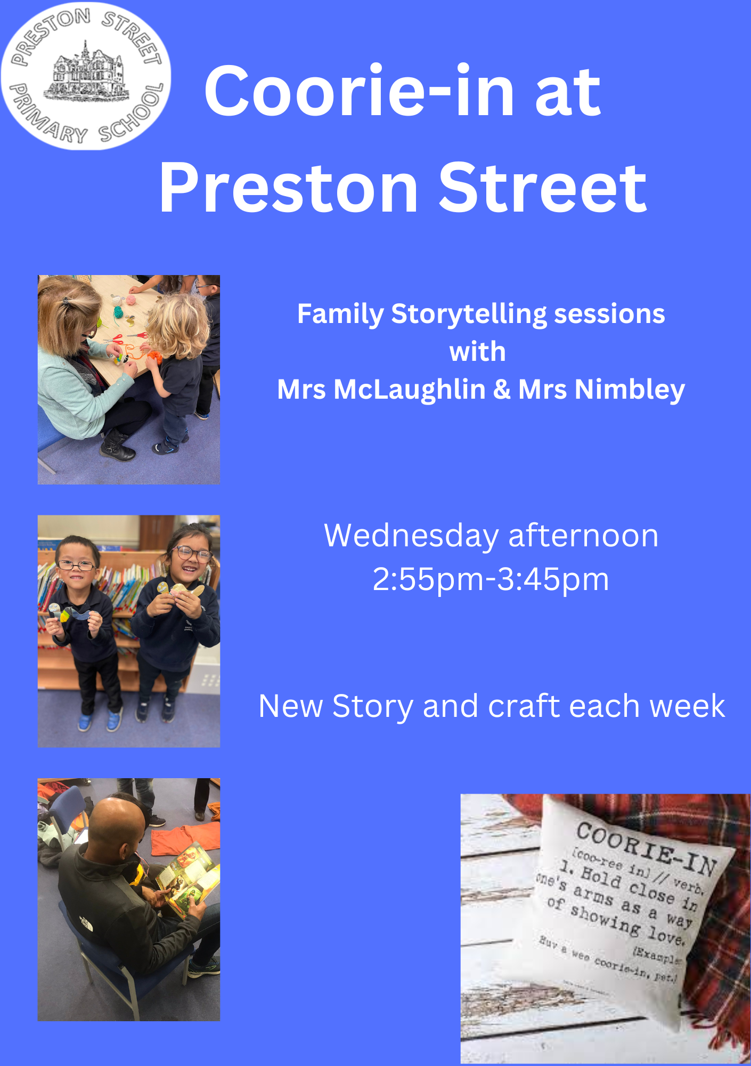
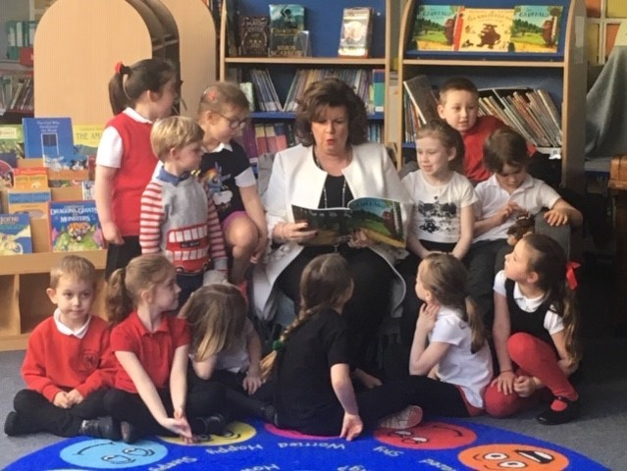
Coorie-in
One school’s bid to save bedtime stories from extinction
Lisa Black – Acting Head Teacher, Hermitage Park Primary
Lisa McLaughlin – Principal Teacher, Preston Street Primary/ Hope Cottage Nursery

Slide 2
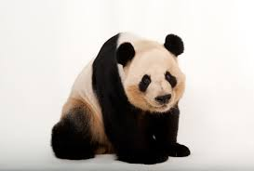
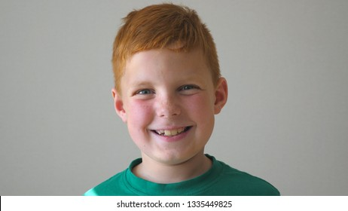
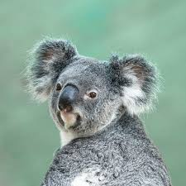
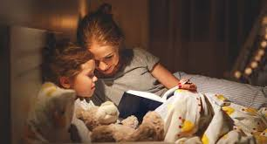
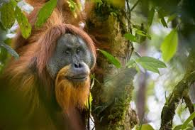
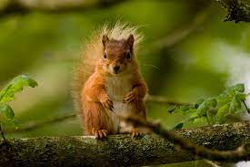
What do these things have in common?
Notes:
The red hair gene could be on the way out due to global warming. The gene that yields red hair and pale skin is more sensitive to hot temperatures so if predictions of rising temperatures are correct evolution might cause it to regress.

Slide 3
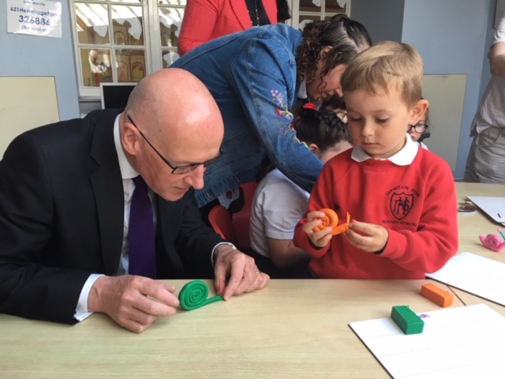
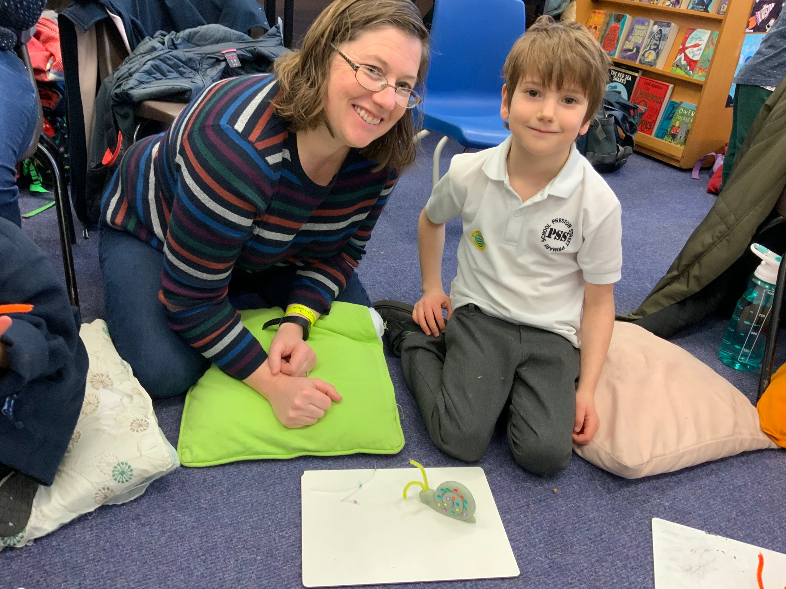
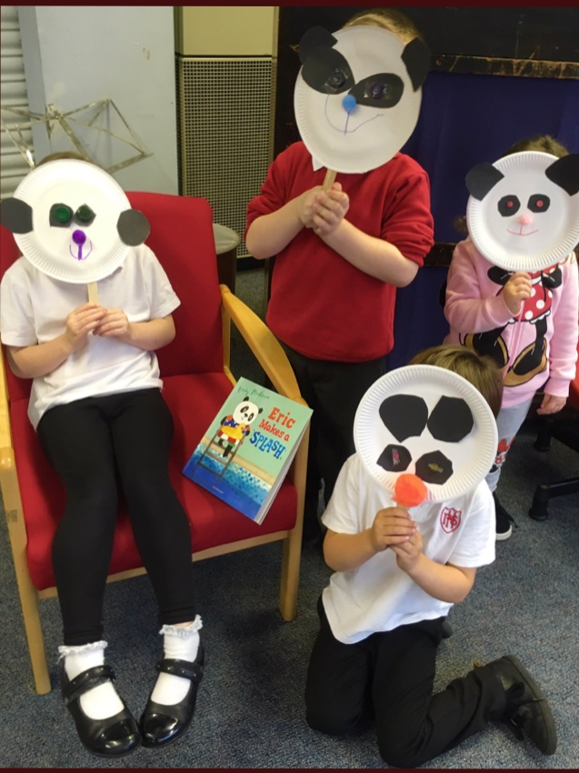
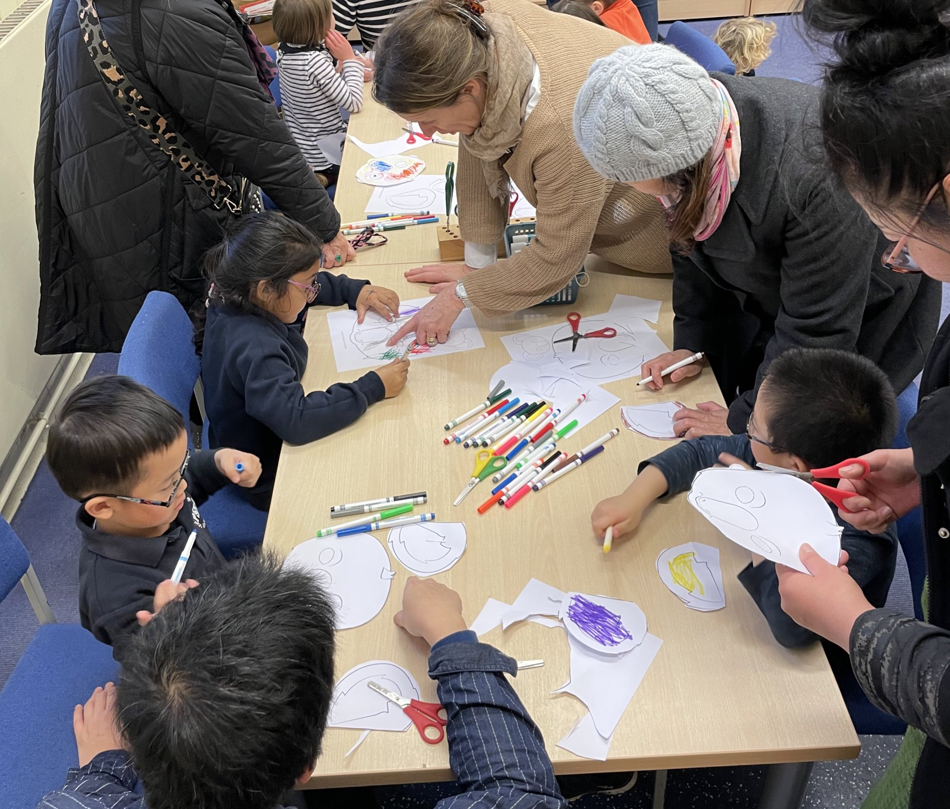
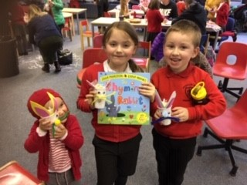
An introduction
Notes:
This little clip introduces Coorie-in perfectly.
You can see from that short clip, Coorie-in ticks so many boxes.
It’s reading for enjoyment, family learning, parental engagement, closing the attainment gap to name a few.
However, these were not at the fore front of our mind when we started it. Let me tell you about the rationale behind starting it.
My Hermie Heroes Pupil leadership group were conducting a study on bedtime routines.
They asked children what they did in the hour before they went to bed to go to sleep.
Let’s see if you can predict the results of their study.
KAHOOT
1. What percentage of the whole school read a book by themselves?
2. What percentage used technology?
3.What percentage shared a bedtime story with a family member?
4. What percentage did something else? (toys, draw, music)
Now P1&P2
1. What percentage of the whole school read a book by themselves?
2. What percentage used technology?
3.What percentage shared a bedtime story with a family member?
4. What percentage did something else? (toys, draw, music)
Let’s recap.

Slide 4
The rationale

Slide 5
Notes:
Bedtime stories were facing extinction. Like all endangered species, needed help to ensure its survival.
Two pronged approach;
Family reading session
Coorie-in bedtime story channel
Lisa talk about Family reading sessions.

Slide 6
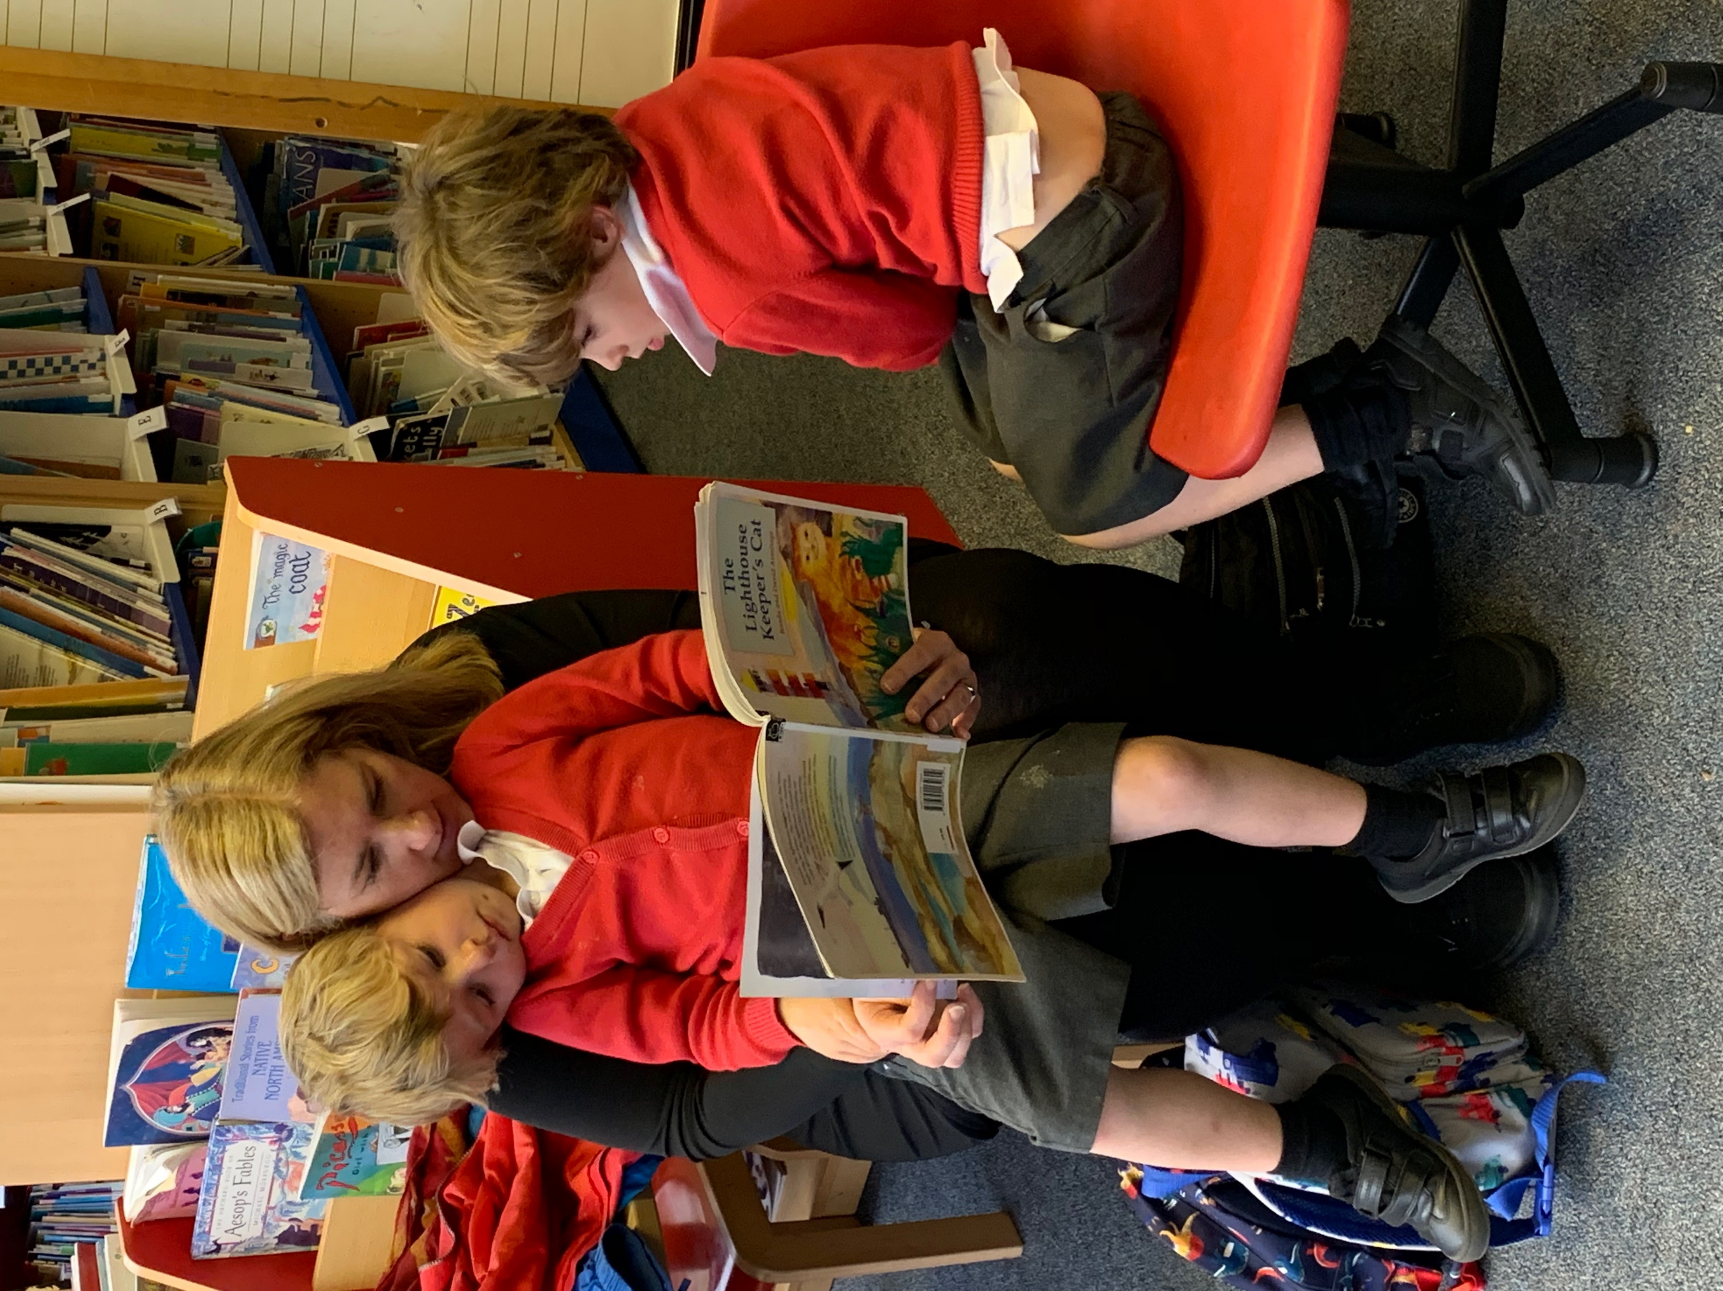
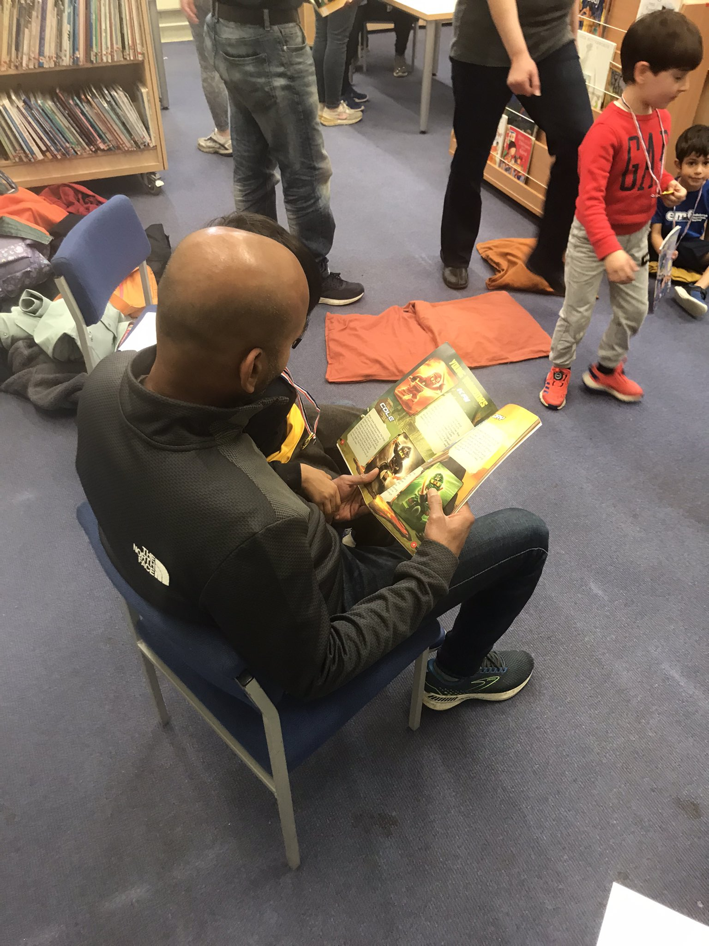
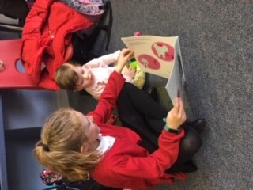
How the ‘Coorie-in’ supports Early Literacy
Our initiative promotes the value and pleasure of reading
Books spark growing imaginations, stimulate critical thinking and help to develop empathy. Reading gives children the skills they need to succeed at school, at work and in life.
Parental involvement in early literacy is directly connected to academic achievement.
Notes:
Early Literacy
Learning to read and write doesn't start in nursery or Primary 1. Developing language and literacy skills begins at birth through everyday loving interactions, such as sharing books, telling stories, singing songs and talking to one another. Fewer children are coming to school with experience of these kind of interactions.
It helps with their ability to understand words, use their imagination and develop their speech, as well as being something they really enjoy.
language is the vital stepping stone to literacy and there is very clear evidence that poverty and deprivation continue to impact on children's ability to read well. Illiteracy impacts on all areas of a child's life.
Children need parents to be their reading role models. Interestingly, a recent survey by the National Literacy Trust found that Role models are an important influence in children and young people’s lives. This report looks at children and young people’s role models more closely to identify who they look up to, and what seeing their role model read would make them think or feel about reading.
The survey found that celebrity role models, including YouTubers, have become more prevalent than they were a decade ago, parents continue to be the most important role models for children and young people.

Slide 7
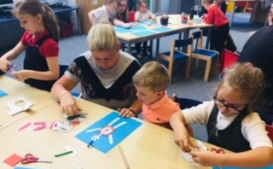
Family Storytelling session
Weekly session for 30 minutes after school for Nursery-P2.
Begin with an opening song followed by a group story.
Craft activity related to the story.
Parent/carers share craft activity.
Finish with a closing song.
Time given to parent/carer to read a story with their child in the library.
Notes:
The familiar structure of our sessions is a key to it’s success. Each week we follow the same format
The story is different every week. We link in with class teachers and practitioners to find out if there is an interest in the classroom or a particular author the children are enjoying. In my sessions at Preston Street, I tend to focus on stories which have an emphasis on repetition, rhythm and rhyme. Rhyming helps babies and children learn about words, sounds and language formation. Hearing and using rhyme, rhythm and repetition helps children develop early literacy skills. The repetition of words, ideas and skills is important for early brain development, as it creates secure foundations for early learning. At Hermitage Park, their focus is on boosting vocabulary which Lisa will explain more about later.
Within our sessions, Lisa and I model reading aloud. Reading books aloud to children stimulates their imagination and expands their understanding of the world. It helps them develop language and listening skills and prepares them to understand the written word.
Our shared craft activity is another bonding experience for parent/carer and child and is another way a child’s literacy skills can be developed further through the conversation which occurs.
Offering time at the end for the opportunity to read a book together is another highlight of our sessions. It places a value on looking after books, reading for enjoyment and that important aspect of the chance to ‘coorie-in’ and share a story together.

Slide 8
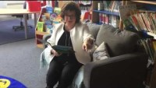
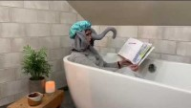
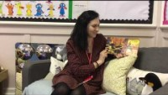
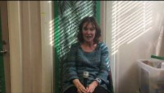
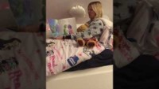
‘Coorie-in’ digital bedtime story channel
Notes:
So we worked with our digital learning team to set up our own ‘Coorie-in digital bedtime story channel.
-Logistics of copyright and safeguarding (no children allowed in it)
-Staff, authors, celebrities, Hibs, politicians read favourite bedtime story, we recorded it then sent private link.
-Criticism that yet more technology, but found was watched it together, then encouraged them to pick up a book
Here are some examples…

Slide 9

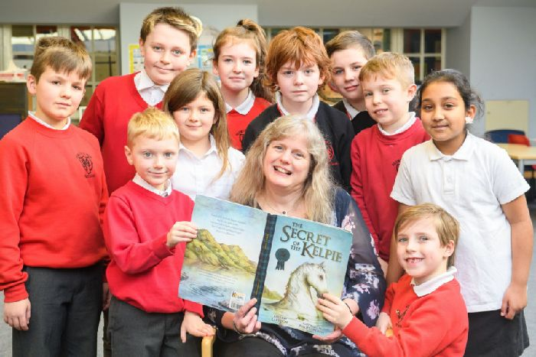
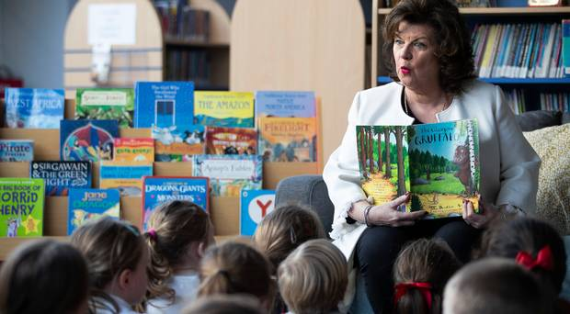
Press Coverage
Elaine C Smith helps youngsters ‘coorie-in’ with online bedtime story project
The Scots star read her book The Glasgow Gruffalo for youngsters at Hermitage Park Primary in Leith, after it set up the online initiative.
Leith school setting up online channel to read bedtime stories
The General Teaching Council for Scotland
Bringing back the bedtime story using play-based learning
Notes:
Lisa is about to talk about the impact of our Coorie-in.
Firstly it attracted international press coverage.
Don said: “Of course, a story on screen isn’t the same as sharing a book in person with a child at bedtime.
“But this is a creative way to harness the opportunities provided by new technology to address an issue created by the stress of modern life.
“Coorie-in will offer bedtime stories that can be enjoyed by children every night. This is a great idea by Hermitage Park and I’m delighted to be taking part.”
Now more details on impact.

Slide 10
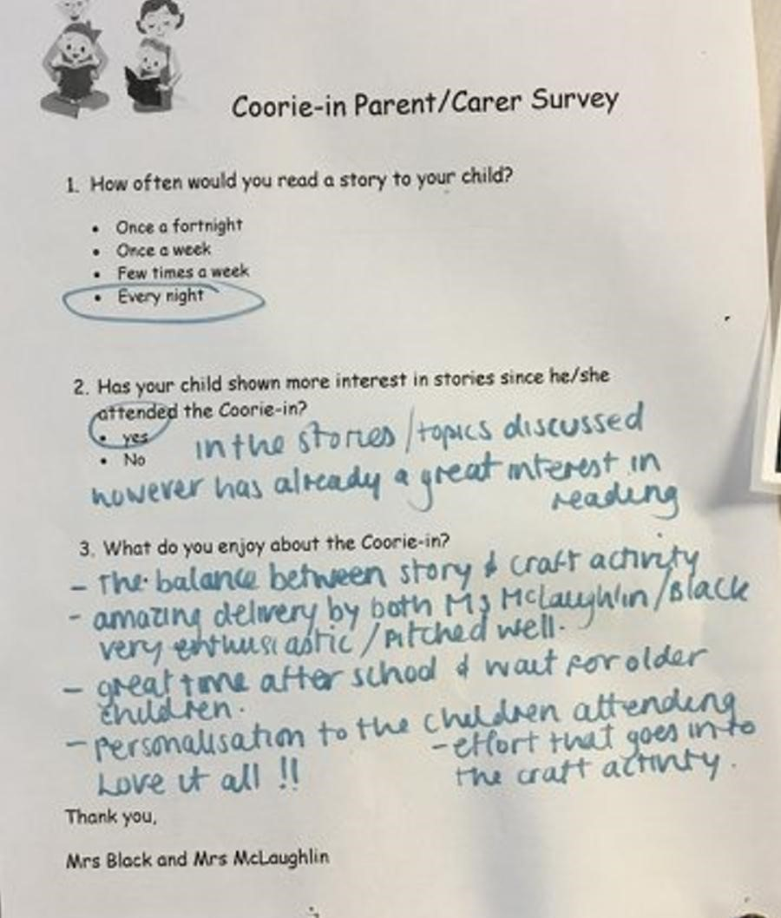
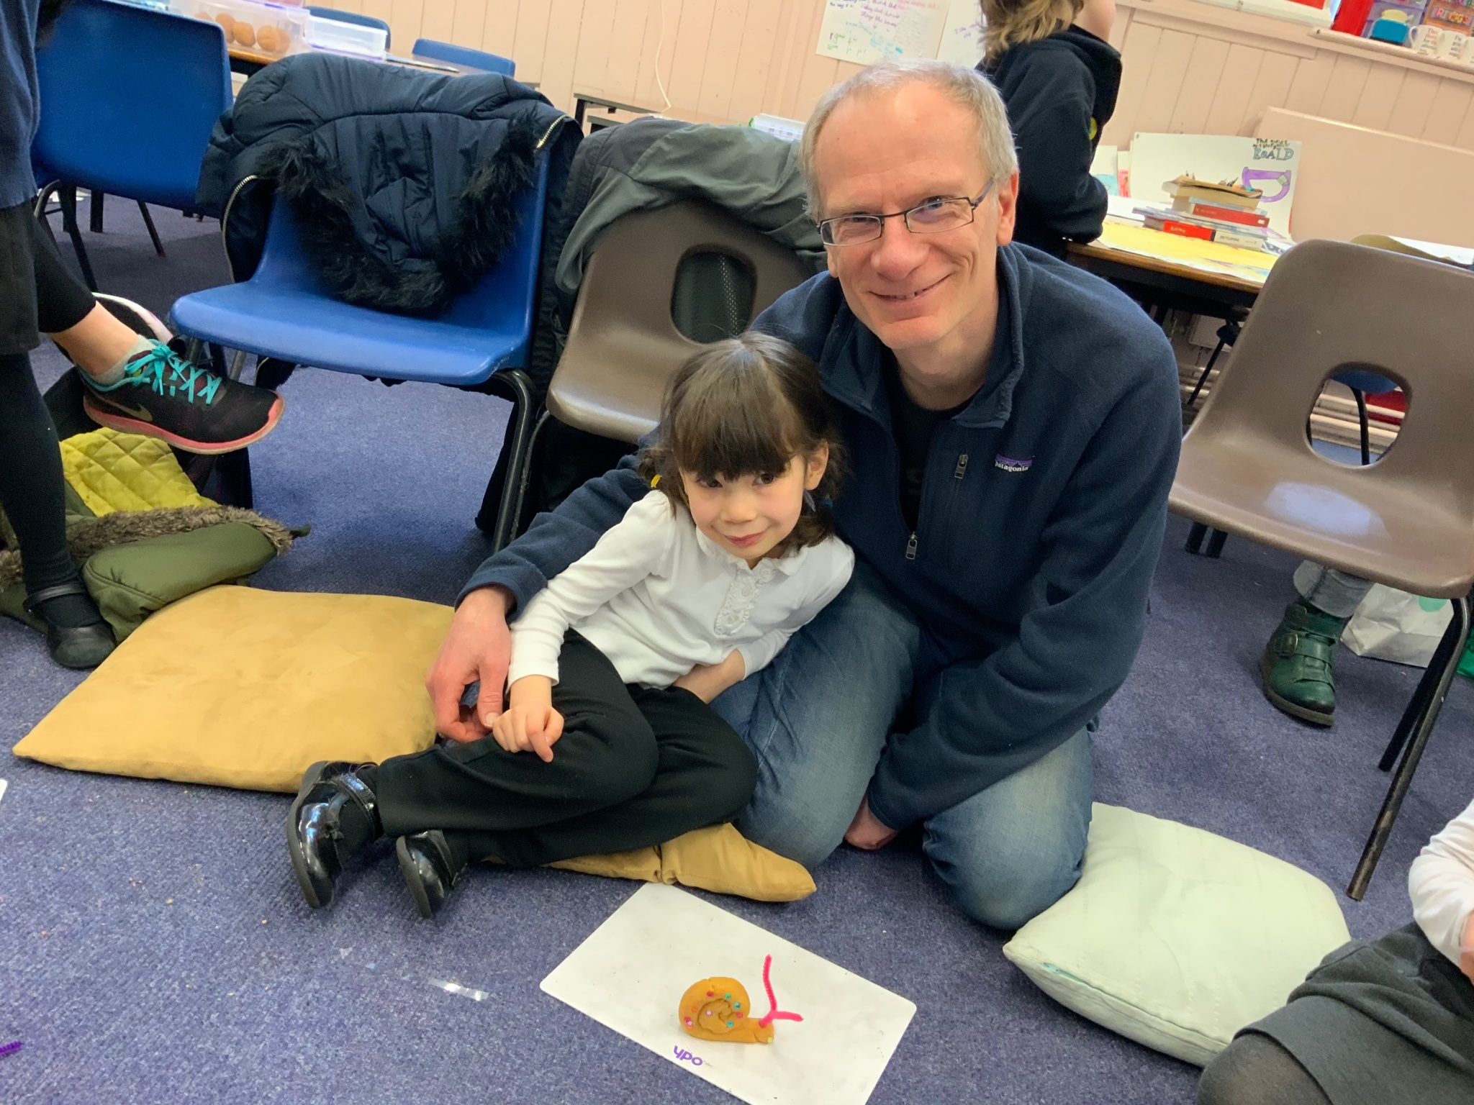
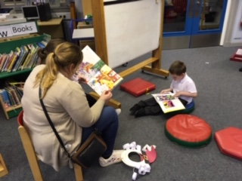
Parent/Carer Feedback
I enjoy watching the children sitting and listening, enthralled with the stories. It helps create a calm relaxing environment after a busy day at school.
I enjoy being part of an activity in school and doing something together with my child
The balance between story and craft activity is perfect. Personalisation to the children attending. Love it all!
Notes:
After the initial session we conducted a Parent/Carer Survey asking views on our ‘Coorie-in’ initiative.
All the families surveyed said they felt their child’s interest in books had increased since attending the sessions.
They were extremely positive about the structure and delivery of the family storytelling sessions.
Felt their confidence in selecting appropriate stories for their child had increased.
Their understanding of how to share and deliver a story to their child had also improved

Slide 11
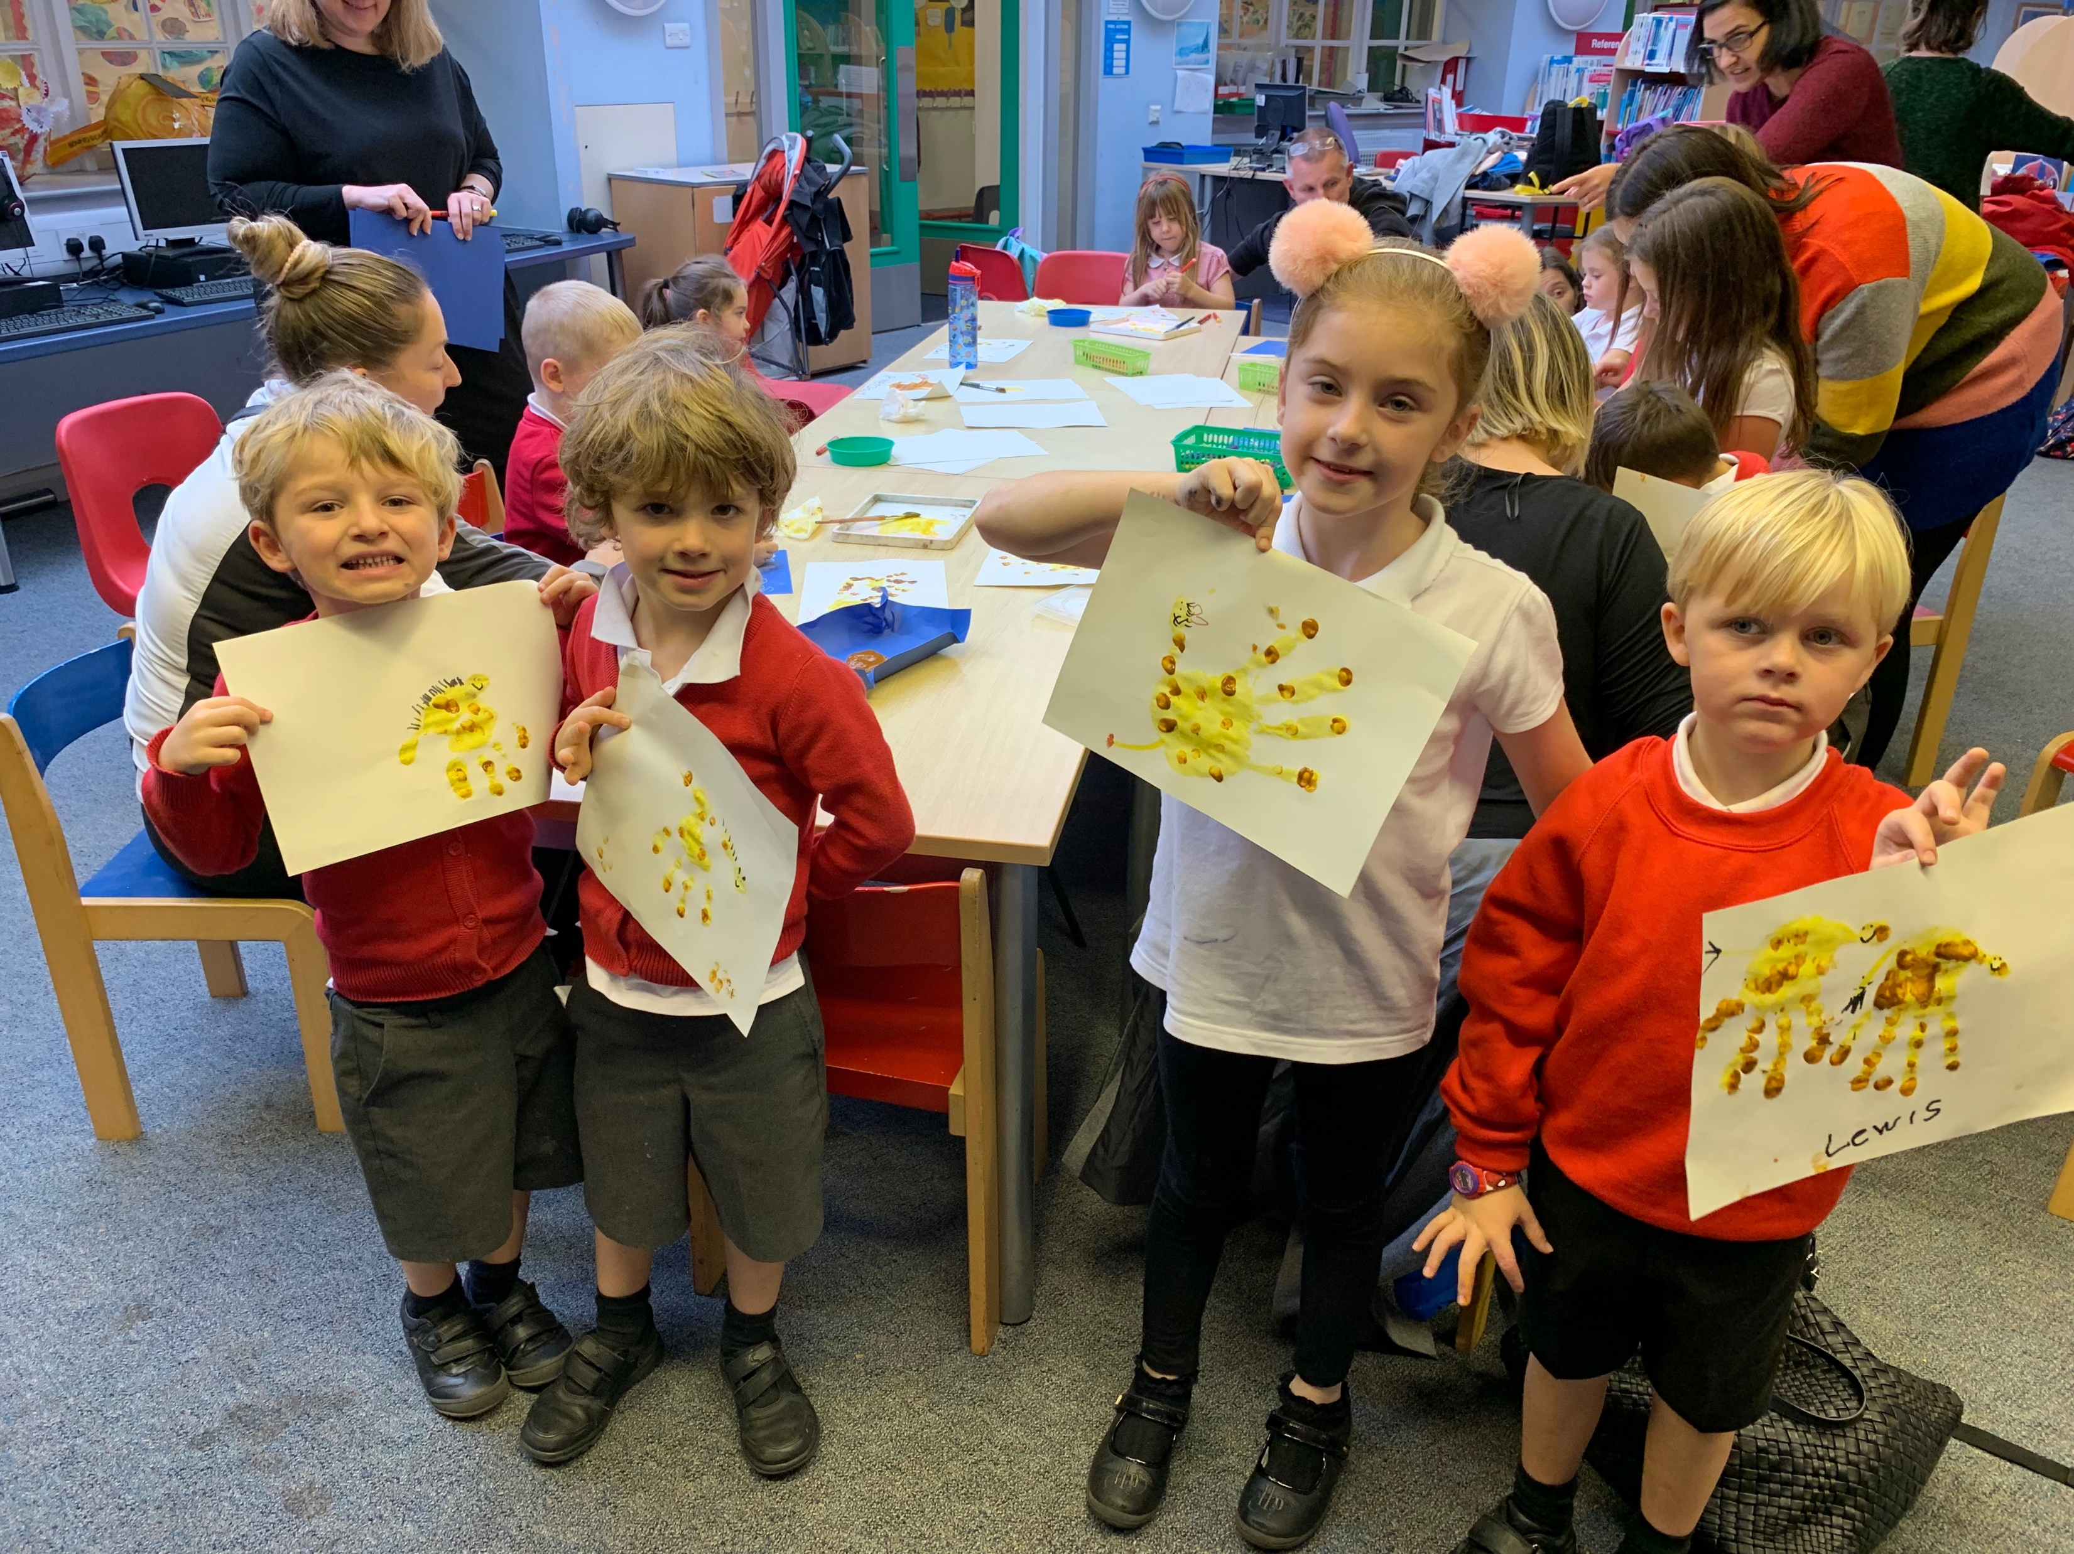
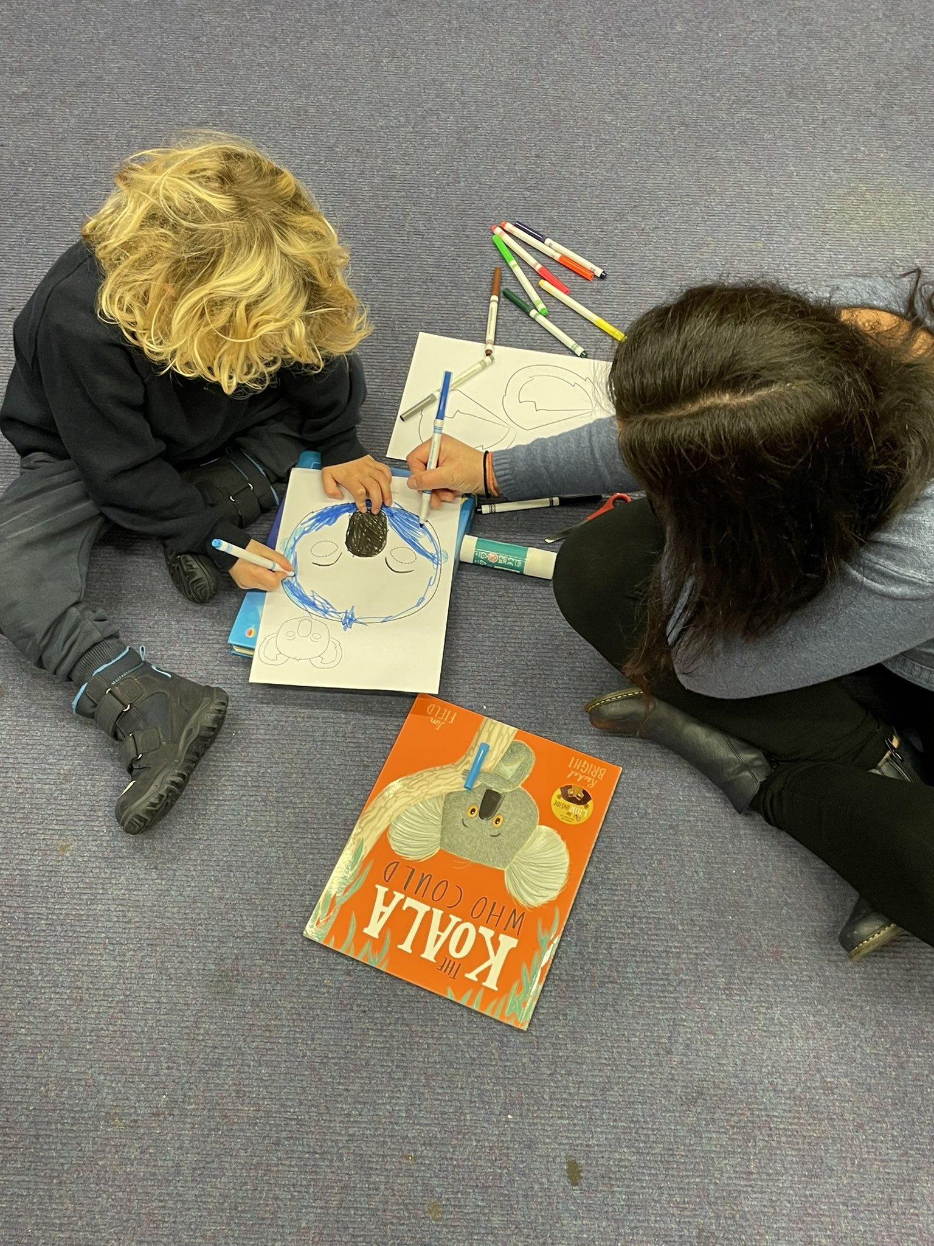
When we go to the library, my child will ask for the stories he has heard in the Coorie-in.
I look forward to sharing my love of stories with my child. His interest in books has developed further since attending the sessions.
What impact has the Coorie-in had for you and your family?
I feel more confident at selecting stories my child will enjoy.
Notes:
What impact has the Coorie-in had for you and your family?
Families sharing their love of reading with their child.
The types of stories we shared with families gave them more confidence to choose appropriate texts with their child.
Increased interest in attending the local library and choosing books. We also invited the local librarian to our Coorie-in session so our children could find out more about how they could use their local library and the importance of this vital hub which serves their local community.

Slide 12
What do you do before you go to bed at night?
Whole school – 321 pupils | Feb ‘19 | June ‘19
Technology | 61% | 52%
Read a book by yourself | 19% | 22%
Bedtime story | 13% | 21%
Other (e.g. play with toys, draw, music) | 7% | 5%
Have you watched our online bedtime story? | - | 61%

Slide 13
What do you do before you go to bed at night?
P1-P2 102 pupils | Feb ‘19 | June ‘19
Technology | 60% | 45%
Read a book by yourself | 5% | 7%
Bedtime story | 33% | 46%
Other (e.g. play with toys, draw, music) | 2% | 2%
Have you watched our online bedtime story? | - | 61

Slide 14
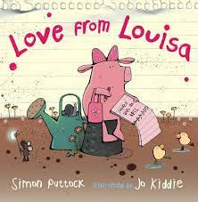
Word Boost Approach
Notes:
Where are we now at Hermitage Park?
45% of our pupils are deemed as living in poverty.
This has lots of implications and closing the literacy the poverty related attainment gap is a big part of my remit.
Ever heard of the 30 million word gap?
By 3 years of age, there is a 30 million word gap between children from the wealthiest and poorest families.
Results from our own data at Hermie supports a gap, especially following Covid.
Fir example, the British Picture Vocabulary Scale indicated that 82% of our pupils were working below the expected level for their age in receptive vocabulary, an average deficit of 18 months was apparent.
I worked with Gill Earl, our Speech and Language Therapist to deliver CLPL together in Word Boost and made up the resources required for each stage.
Word Boost is an introduction to new sophisticated words (boost words) through a new story every week and reinforced through games and activities in class.
Parents are sent information postcards. There is also a lending library so parents can borrow the books.
Incorporate that in our Hermie Coorie-in.
Give example.

Slide 15
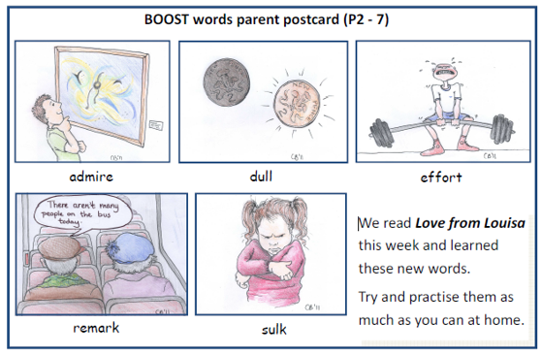
Parent postcard

Slide 16
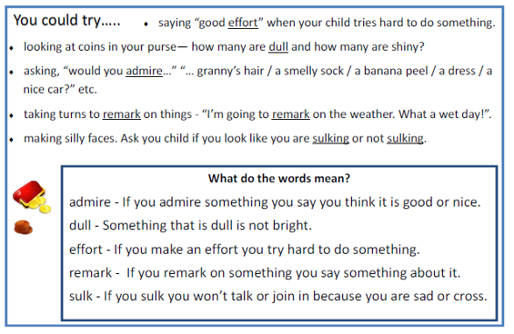

Slide 17
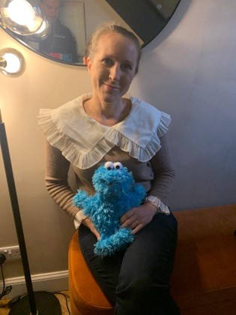
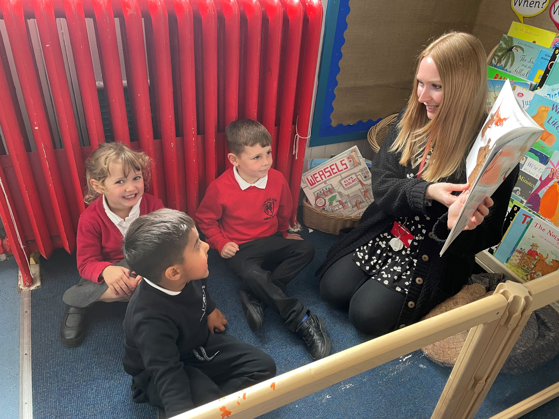
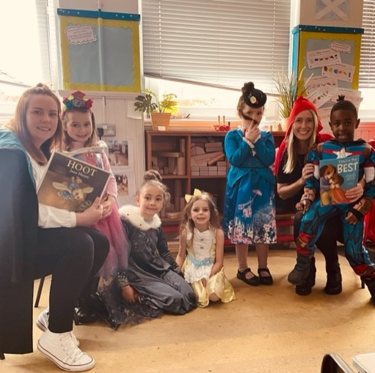
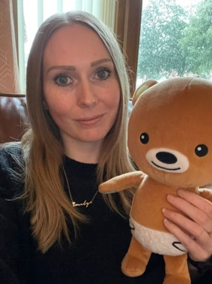
‘Coorie-in’- our family story time sessions led by Hermie teachers.
Come along with your
N-P2 child to listen to a story, sing, do a book related craft and meet other parents.
We ‘word boost’ your child with new vocabulary too.
Fridays at 12:15-12:45 pm school library (enter through the doors where P2 and P2/1 exit from school) No need to book, just turn up.

Slide 18
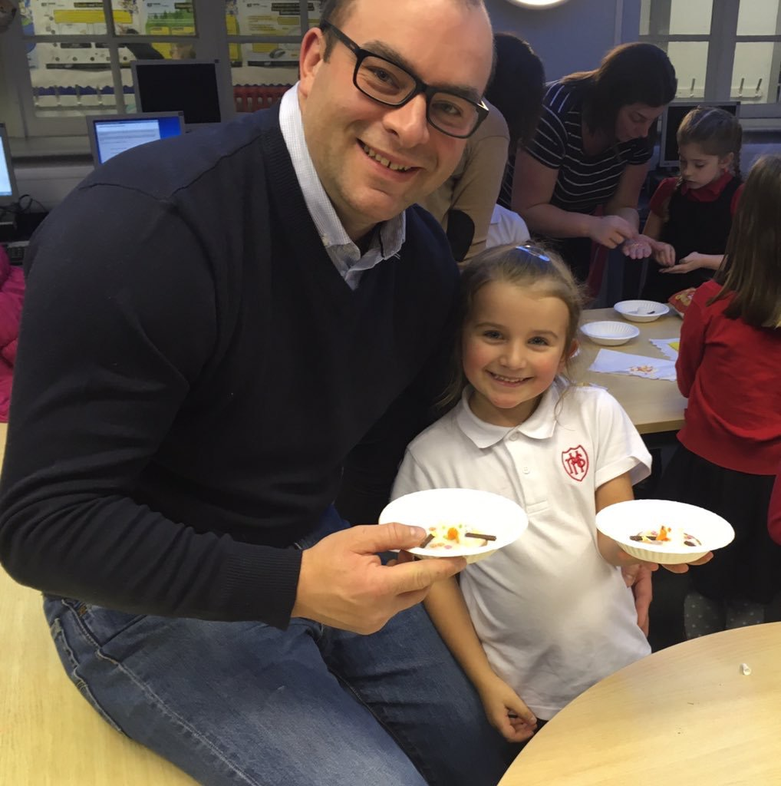
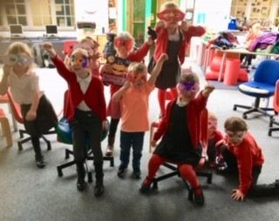
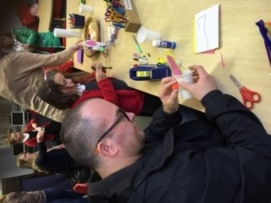
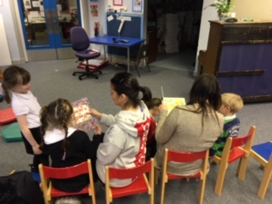
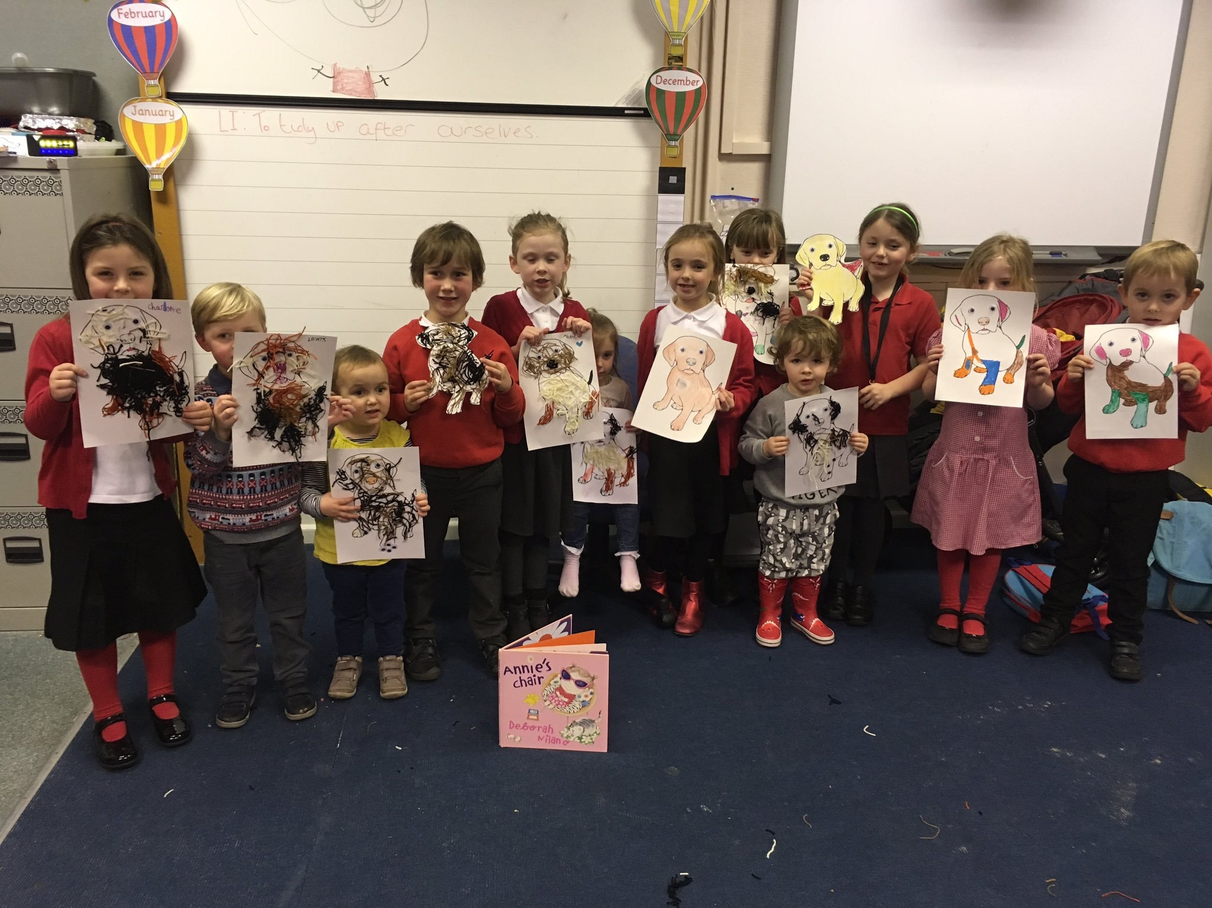
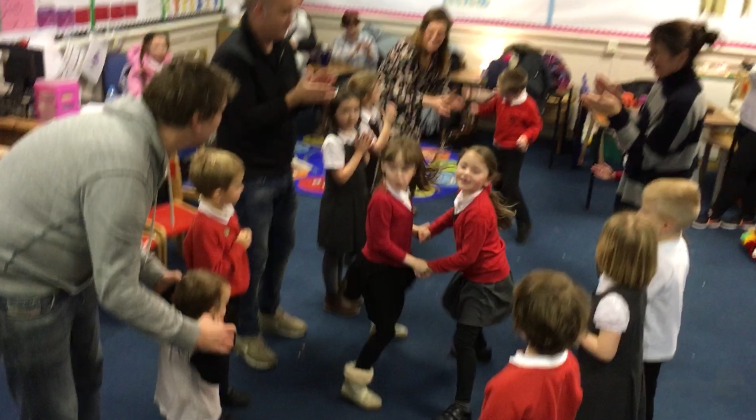
Dates, Books and ‘word boost’ vocabulary
Date | Book | Vocabulary
03/03 | The Smartest Giant in Town | smart, comfortable, match, perfect
10/03 | How to Grow a Dinosaur | glare, scatter, gigantic, rip
17/03 | Who Flung Dung | scoff, trample, ridiculous, culprit
21/04 | Leo’s Dream | celebrate, enormous, investigate, reply
28/04 | I Don’t Want to go to Bed | disappear, belong, stare, scurry
05/05 | The Great Goat Chase | neat, exhausted, wonder, grin
12/05 | Penguins Hidden Talent | talent, eventually, manage, organise
19/05 | Christopher Nibble | imagine, borrow, protect, deep
26/05 | The Train Who Was Frightened of the Dark | cosy, terrified, passenger, entrance

Slide 19
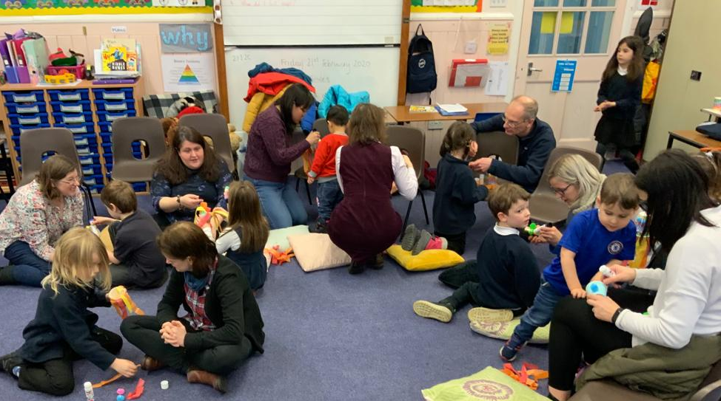
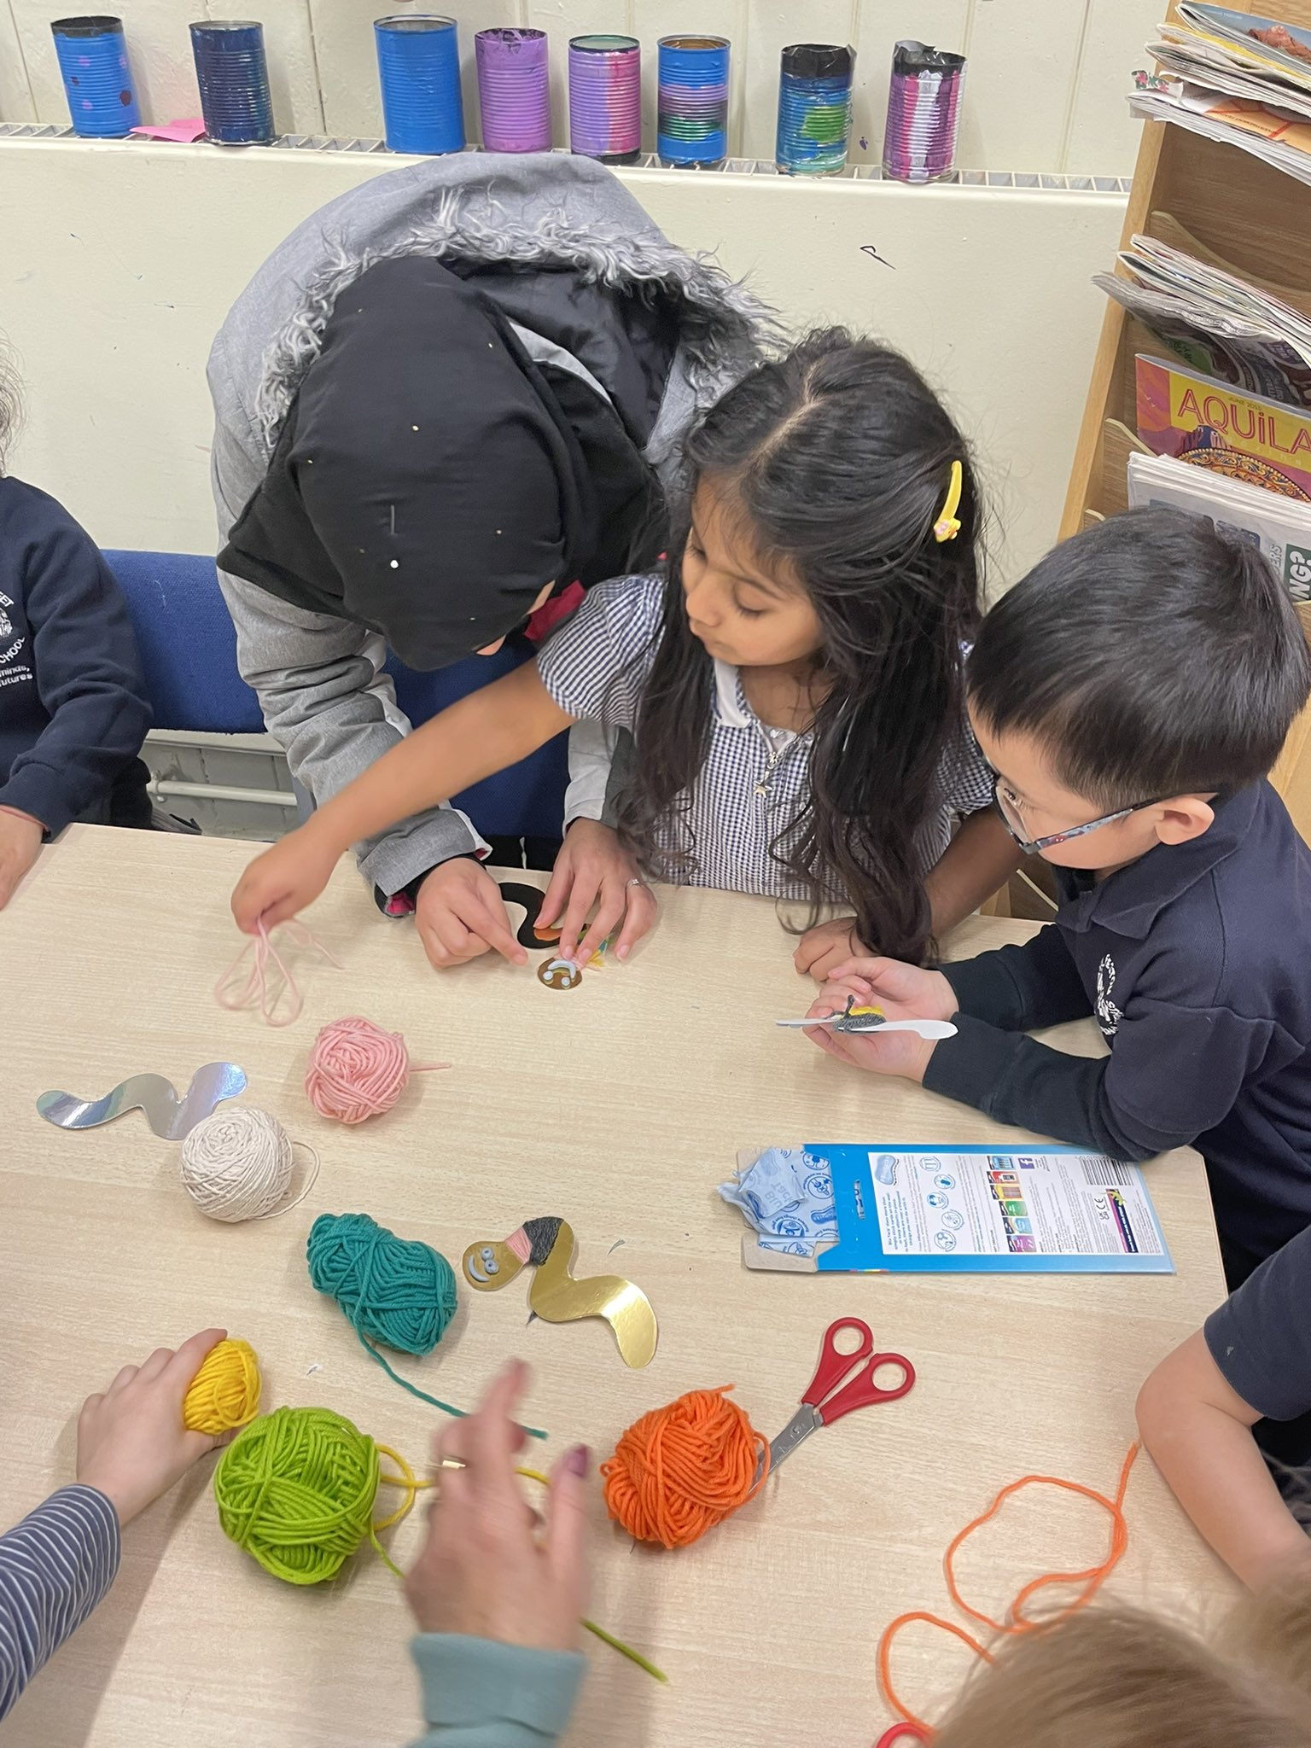
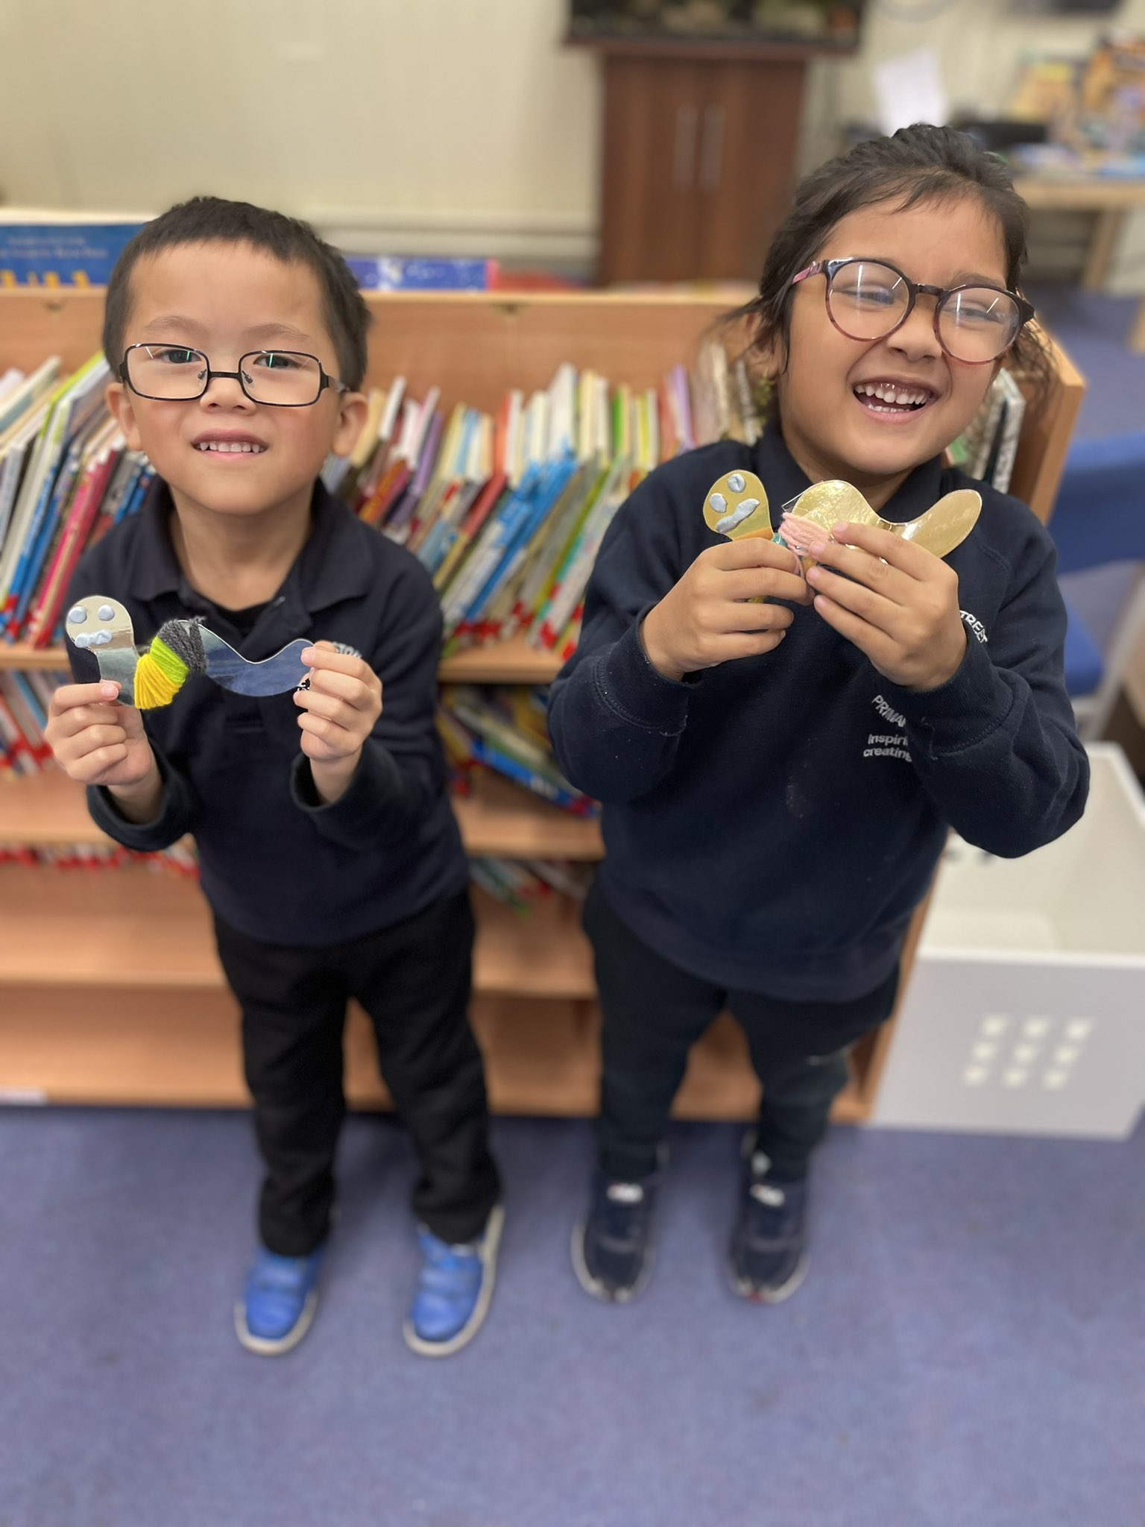
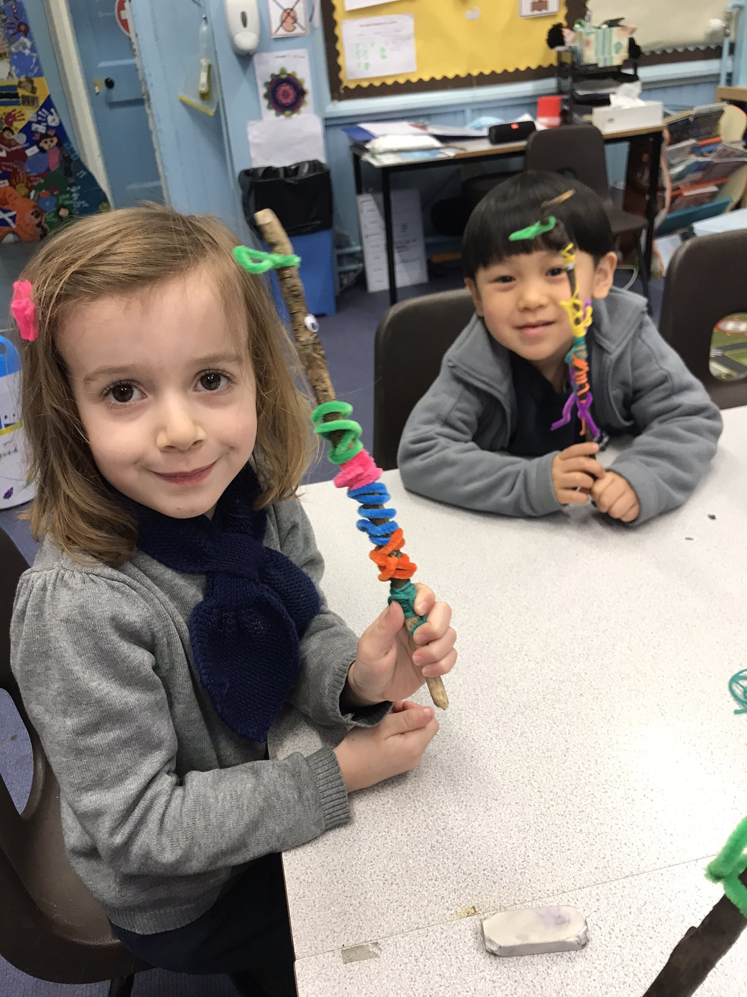
‘Coorie-in’ at Preston Street -
Notes:
At Preston Street, 54% of the school population are bilingual with 28 languages spoken across the school. The three most commonly used languages, other than English, are Arabic, Cantonese, Urdu/Spanish
Stories are one of the most versatile and powerful tools we have and the Coorie-in provides so many speaking and listening opportunities to support our EAL learners. As our sessions are for a parent/ carer to attend with their child, we have found this to be a supportive and inclusive environment where our families can share their own language and support each other with vocabulary and understanding of the story.
For our EAL children, we have found choosing a story with a clear storyline and simple direct language has supported our learners. Picture books can help children learn about other cultures. We have also found using traditional tales and stories can be an ideal way of engaging children with EAL as its likely that they will be familiar with a version of the story. This will help them to understand similarities and differences, which is a crucial thinking skill, and also to understand and develop language.
At Preston Street Primary our teachers have also been involved with a shared project with the EAL Team. In P1 we have been focussed on using a Story based approach where we work on the key strategies of:
*Supporting Understanding text
*Prediction
*Developing vocabulary
We have used the book Tiddler by Julia Donaldson to support this. The use of puppets, real life objects, picture sequencing and opportunities for choral rehearsal have all contributed to supporting the EAL learners to understand the story, learn knew vocabulary and predict what will happen in the story. These are strategies we have also adopted within our Coorie-in session.
A concept the EAL team have been developing is something called ‘’Trio Talk’ – this is used because talking in threes means a child who is new to English doesn’t feel he is under pressure to contribute to the discussions as he would be in a ‘two’ The child new to English can input when he/she feels able to contribute.
This shared project with the EAL team has enhanced the practice of our teachers and as a result means we have different ways to support our EAL learners and their families.

Slide 20
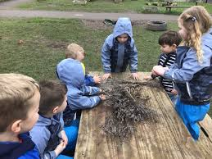
Questions?

